Slide 1
National Hockey League Network Analysis
CPSC 572/672
Social Network Analysis and Data Mining
Emmett Collings
Banafsheh Khazali
Fall 2022

Slide 2
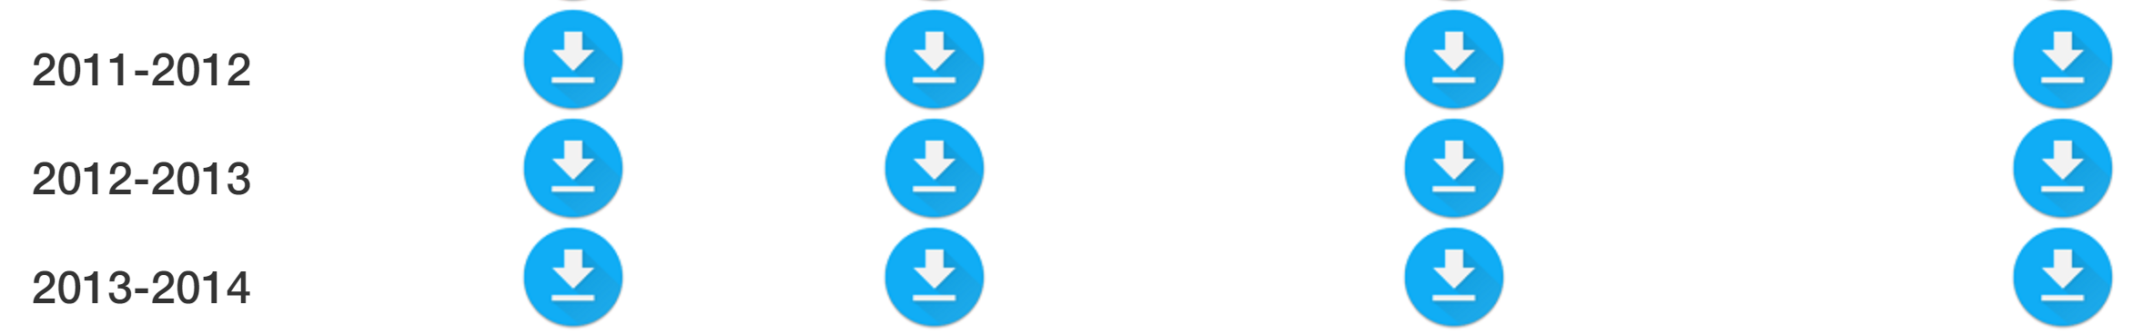
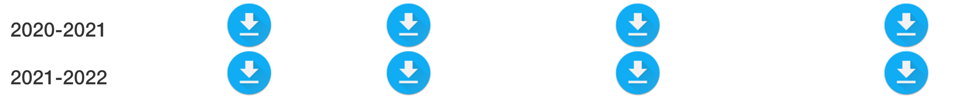
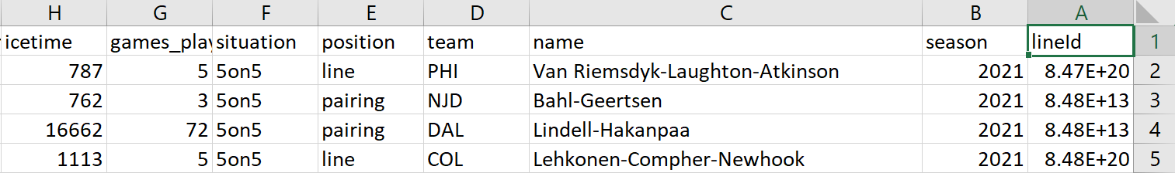
Data Acquisition
Dataset name: National Hockey League Dataset
Source: https://moneypuck.com/data.htm
Data: player and team raw data CSV network format

Slide 3

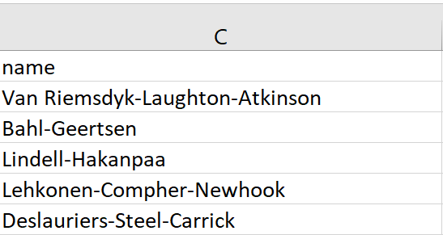

Network Description
Nodes: Individual players
Edges: The link between players if they have been deployed together for more than 600 minutes in a season at 5-on-5.
Network Size
Nodes: ~2000, over a 10-year period.
Edges: 10000+, each player has at least one partner.

Slide 4
Questions we plan to ask and why we care?
Questions
What players are the most/least effective at increasing the effectiveness of their linemates?
Are there players that notably affect linemates in specific metrics such as defensive or offensive play?
Are there potentially more effective player deployments that synergize more effectively?
Can a player's synergistic effects with other players be inflating/ deflating their contract value?
Why do we care?
Sports leagues are hyper competitive.
more successful teams have immediate financial successes.

